Slide 1


Covid – 19 Management System
With My SQL Server and Python
Project Supervisor
A. D. Mairale

Slide 2
Team Introduction
Swapnil Chhotu More(DS-043)
Sachin Bhaskar Patil (DS-044)
Parag Mohan Patil (DS-060)
Narendra Asaram Patil (DS-042)

Slide 3
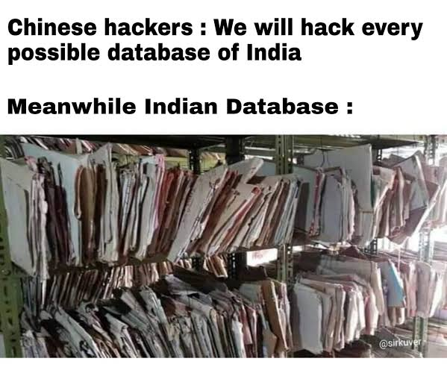
Why we choose this project?

Slide 4
Introduction
The Software is for the automation of a tiny Hospital Management.
It can be used in any Hospital, Clinic or Dispensary for maintaining patient details and their results.
The details gives the doctor, staffs details and patient details including doctor's appointments and the billing system.

Slide 5
Abstract
Covid-19 Data management system is console-based python program this system is simply mini project. You can use this console program to perform basic Hospital data like patients, doctors information, covid test results and discharge patient list data Record functions such as adding patient information, viewing newly added patients, searching for existing patients, and so on. This report includes a development presentation of an information system for managing the covid-19 hospital data within a hospital. The system as such as it has been developed is called covid-19 Management System. It consists of functionally based on python program and database queries. The choice of the programming tools is individual and particular. In this project we tried different python programming ideas and SQL database to implement this system or program

Slide 6
Preliminary study
Planning
Analysis
Design
Logical Design
Physical Design

Slide 7
Objective Analysis
Admin Panel:
Patient admit in hospital.
Patient details:
Patient bio data.
Doctors:
Doctors detail.
Covid Releted detail:
Covid test results.

Slide 8
Output Result
Patient Detail.
Doctor Information Data.
Patient Discharge data.
Covid Patient test records.

Slide 9
Project Requirements
Operating Systems:
Windows 11
Windows 10
Database:
My SQL Server
IDE and applications:
V S Code
My SQL Workbench 8.0 CE

Slide 10
Logical Database Designing
Entity Relationships

Slide 11
Patient
Register
Insert Data
Code
Execution
Administrator
Detials
Doctor

Slide 12
Physical Database Designing

Slide 13
Table
Data Base consist of 4 table : Patient, Doctor, Oxygen cylinder information, Discharge patient list.
Patient :
The patient table consists iof the basic data about the patient.
Doctor :
Doctor consist of information about doctors.
Oxygen cylinder information :
It gives information about availability about oxygen cylinder.
Discharge patient list :
It gives information about discharge about patients.

Slide 14
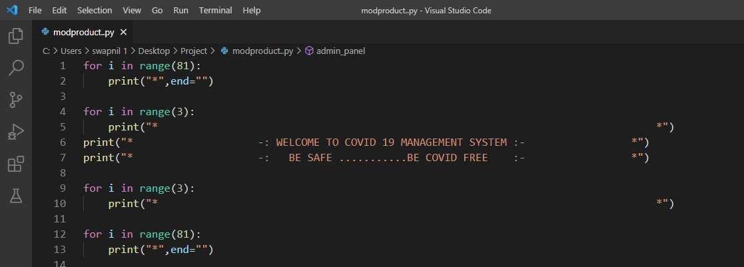
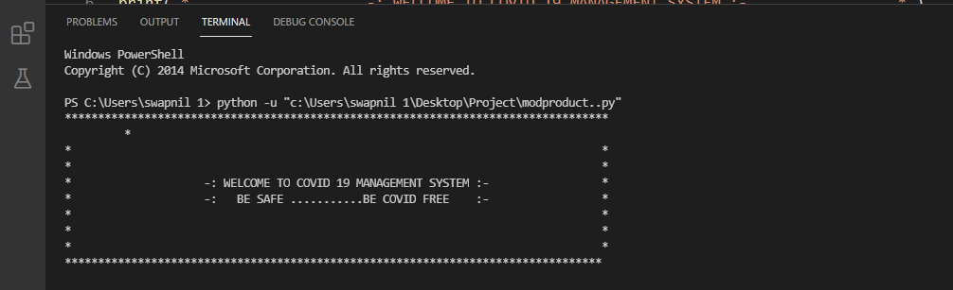
Program Execution
Login interface :-
Output:

Slide 15
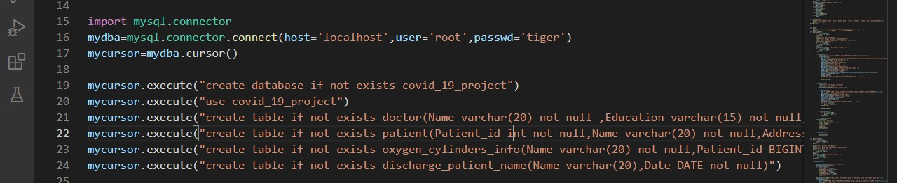
Connection to SQL :

Slide 16
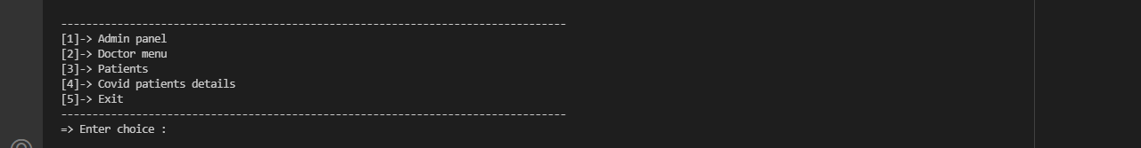
Function of main menu :

Slide 17
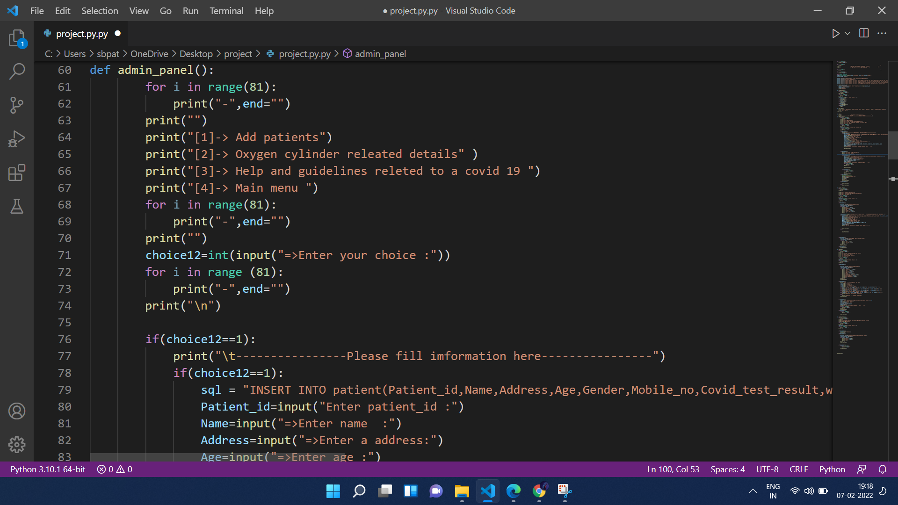
Admin panel function:

Slide 18
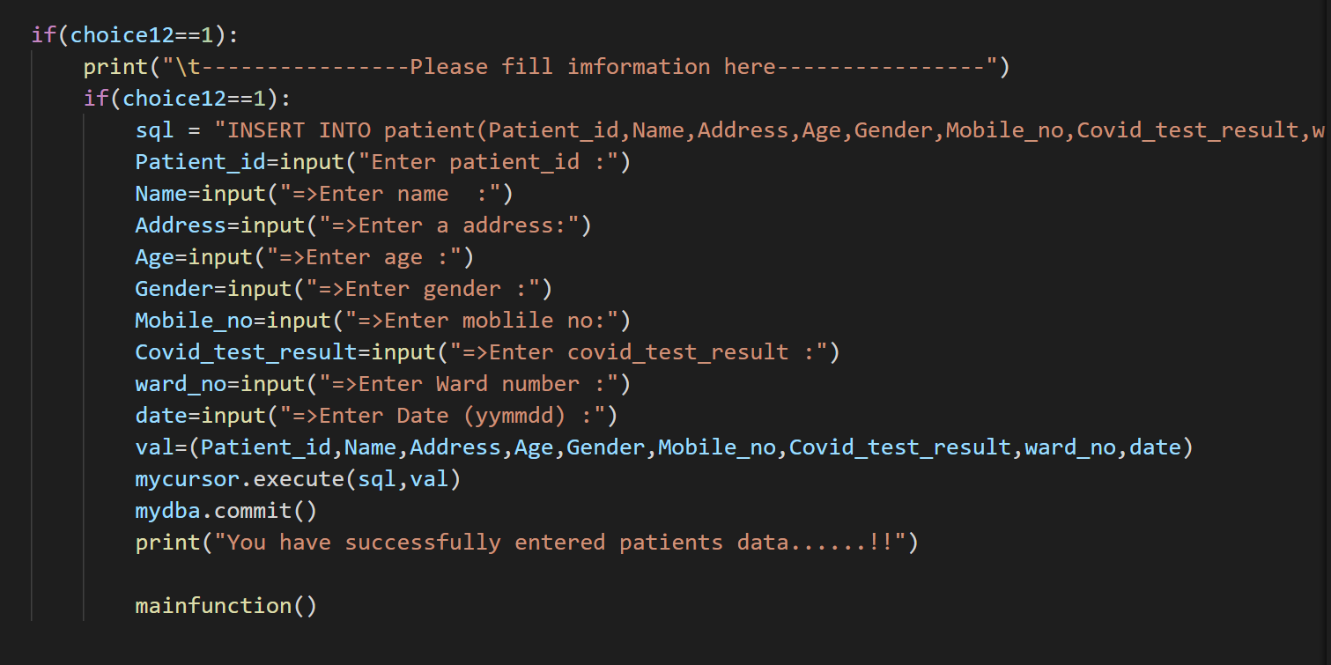
Add patient function:

Slide 19
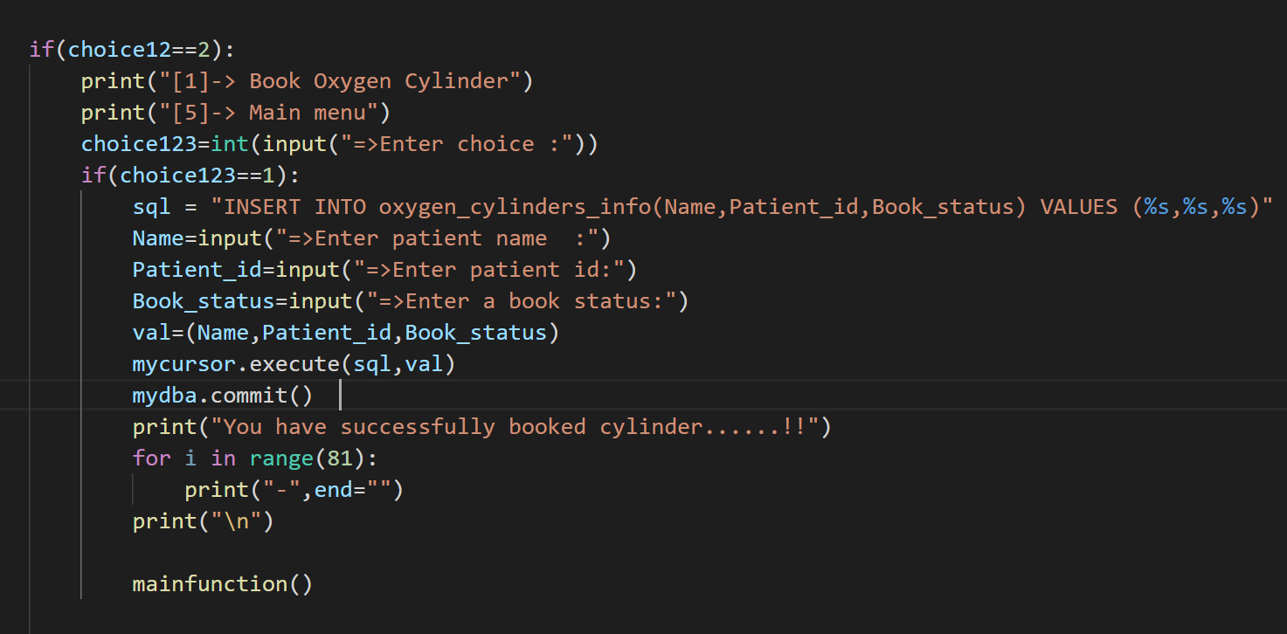
Oxygen cylinder information code

Slide 20
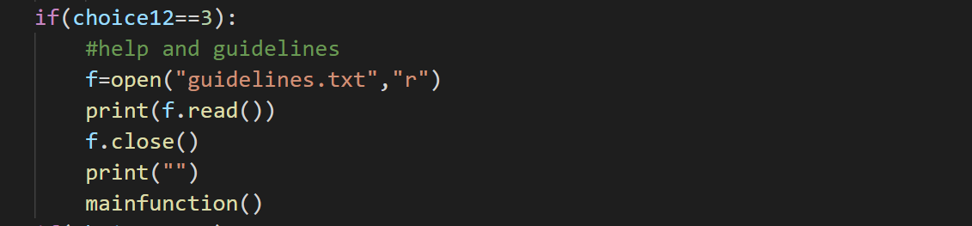
Guidelines code :

Slide 21
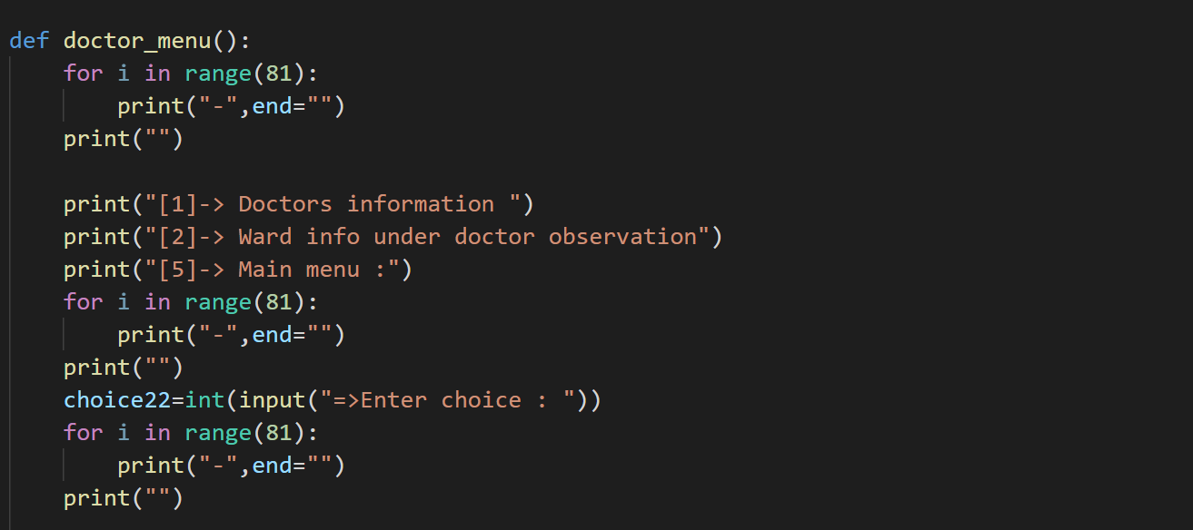
Doctor menu function:

Slide 22
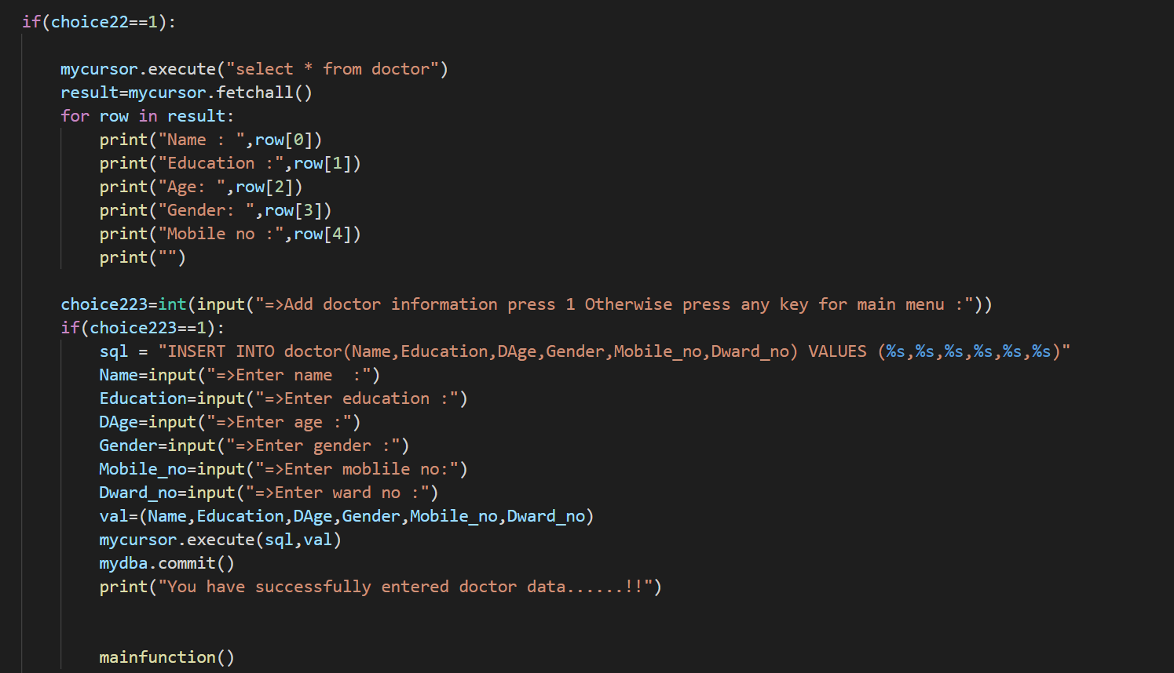
Doctors information code:

Slide 23
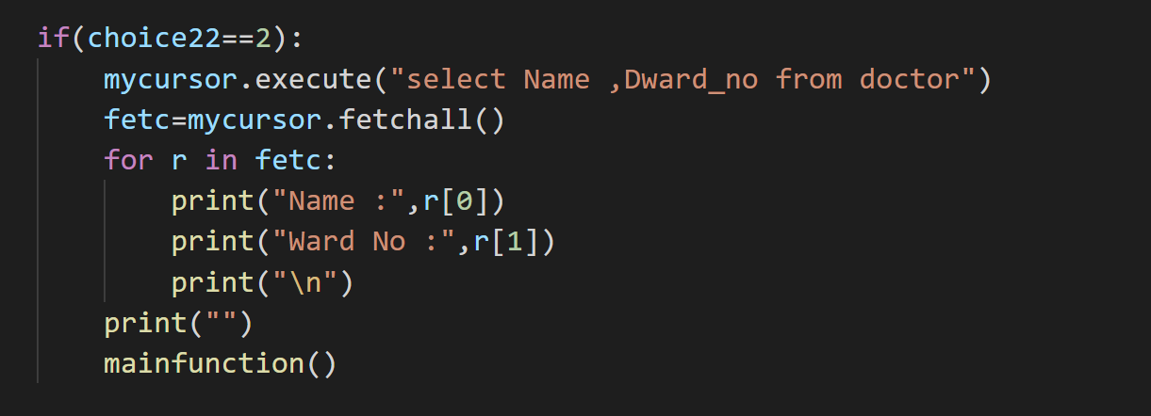
Ward information code:

Slide 24
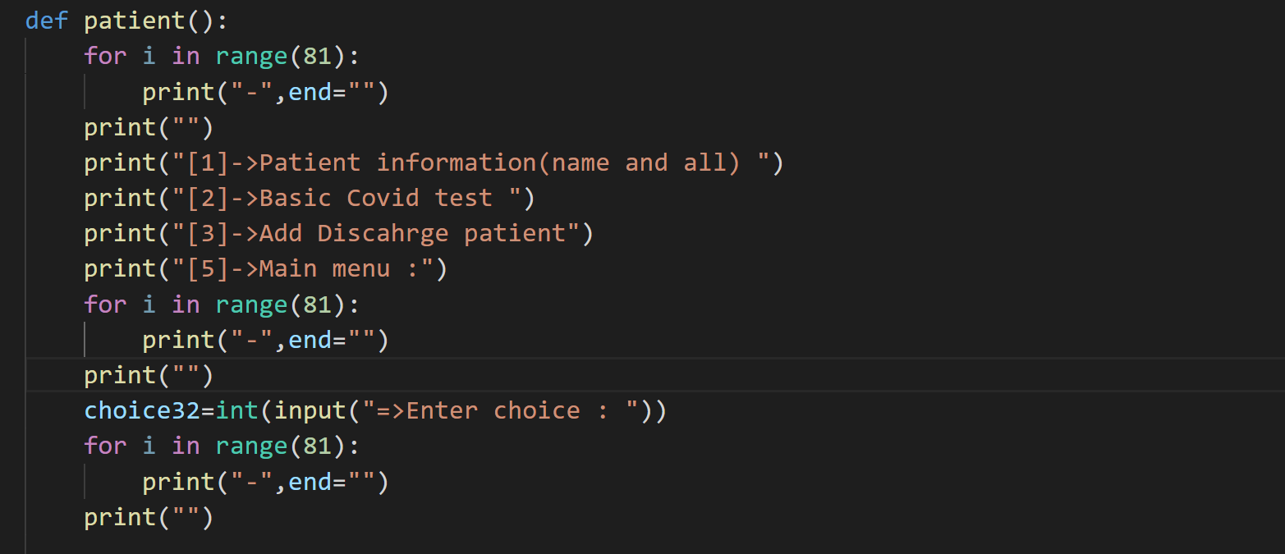
Patient function:

Slide 25
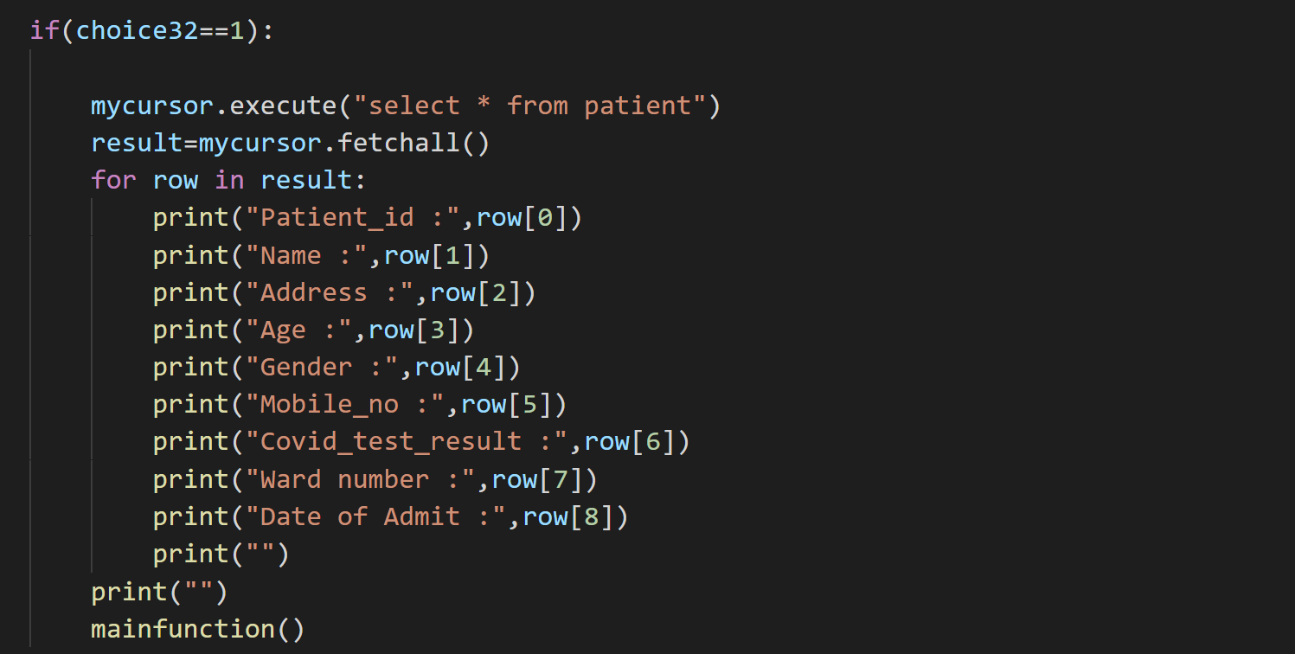
Display Patient information code:

Slide 26
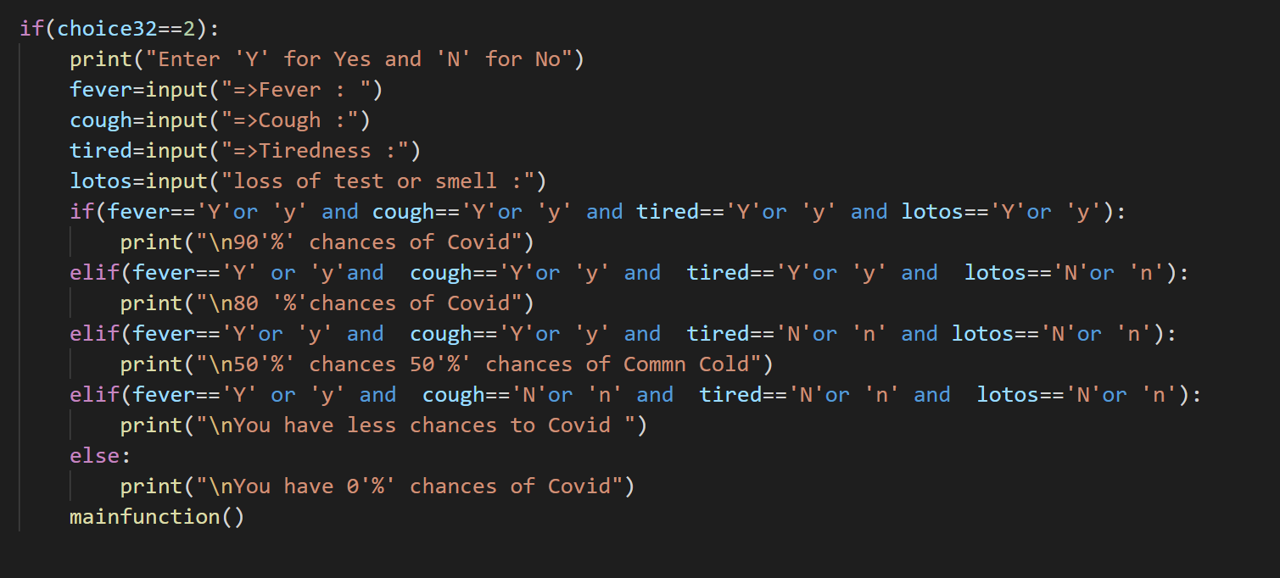
Basic covid test code:

Slide 27
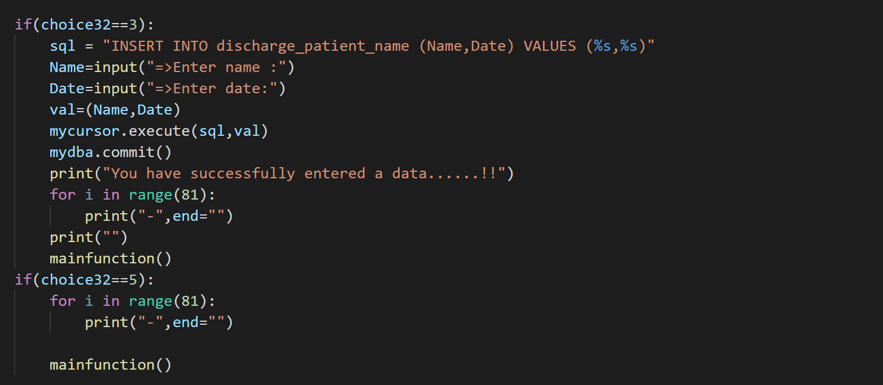
Adding discharge patient code:

Slide 28
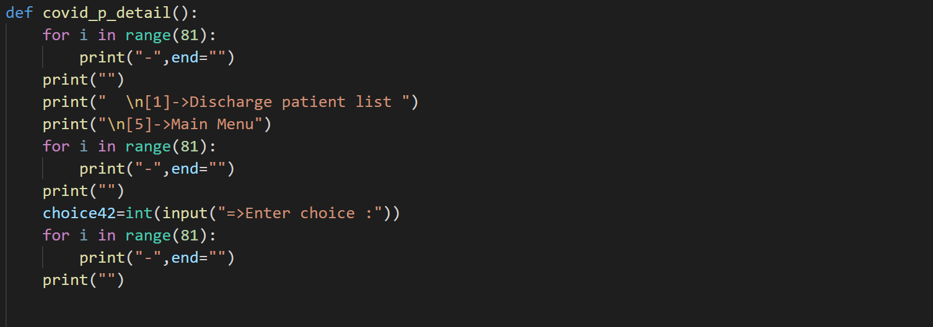
Covid patients function detail:

Slide 29
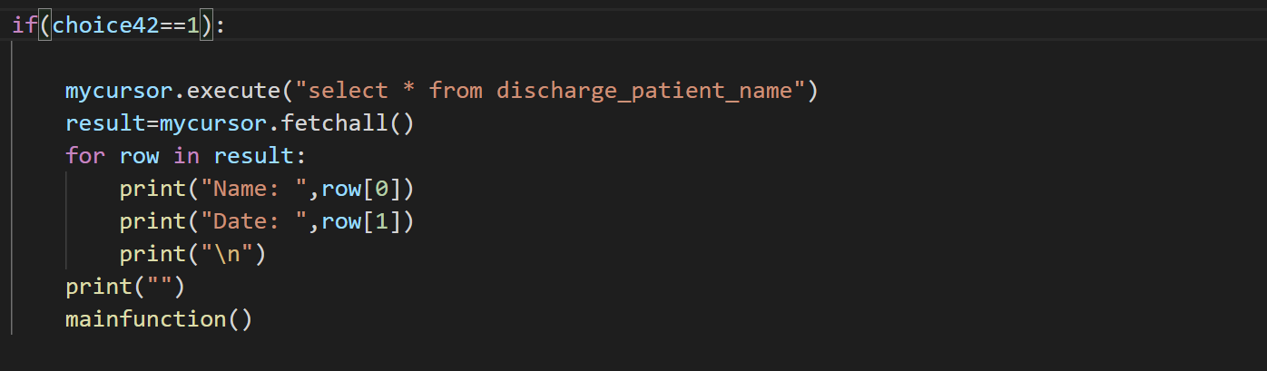
Display discharge patients list code:

Slide 30
Conclusion
The projet covid-19 Management System is for computerizing the working in a hospital. The software takes care of all the requirements of an average hospital and is capable to provide easy and effective storage of information related to patients that come up to the hospital.
It generates test reports; provide predication about including various tests. In short it give us proper management of database and its too easy than traditional database storing system

Slide 31


